Slide 1

CSCI 3280 Tutorial 1 Assignment-1 （C++）
XIE Minshan
msxie@cse.cuhk.edu.hk

Slide 2
Outline
Part 1 Introduction to Halftone
Part 2 Assignment 1 basic part
Part 3 Assignment 1 bonus part
Part 4 Other requirements
Notes:
In this tutorial, we will have a brief introduction on halftoning technique and go through the specification of assignment 1.

Slide 3
Outline
Part 1 Introduction to Halftone
Part 2 Assignment 1 basic part
Part 3 Assignment 1 bonus part
Part 4 Other requirements

Slide 4
What is Halftone?
Halftone is the reprographic technique that simulates continuous-tone imagery through the use of dots.
A process converts a gray scale image into a bilevel image or more generally to an image of fewer gray levels.
Notes:
Many image rendering technologies only have binary out- put. For example, printers can either “fire a dot” or not.
Halftoning is a method for creating the illusion of continuous tone output with a binary device.
A light-emitting diode (LED) is a semiconductor light source that emits light when current flows through it.

Slide 5
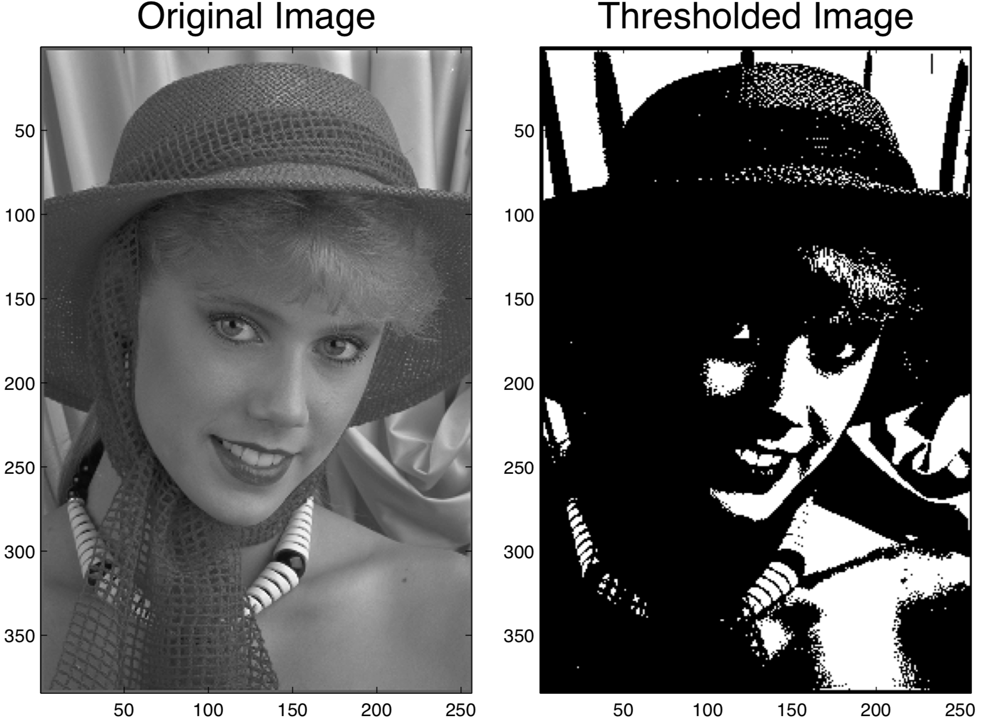
Image Halftoning
8 bits (0-255) to 1 bit (0 and 1)
Binary threshold: produces a poor quality rendering of a continuous tone image.

Slide 6
Image Halftoning
Classical halftoning: reproduce an image by using dots of differing size or spacing or both.
This reproduction relies on a basic optical illusion: when the halftone dots are small, the human eye interprets the patterned areas as if they were smooth tones.
Area of dots is proportional to intensity in image.
Notes:
Right: Halftone dots. Left: How the human eye would see this sort of arrangement from a sufficient distance.

Slide 7
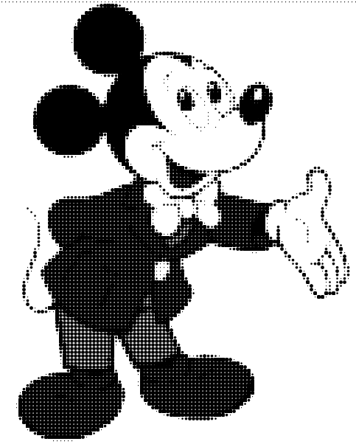
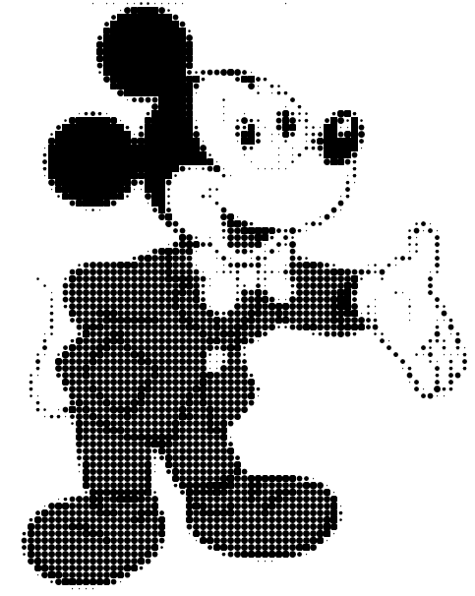
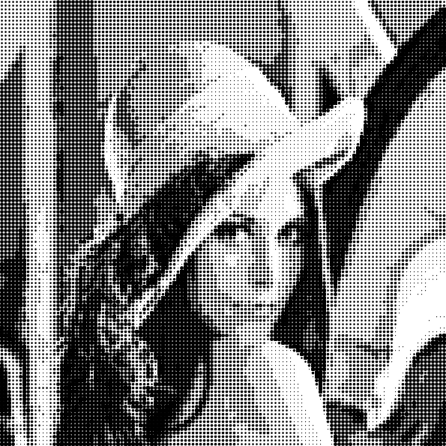
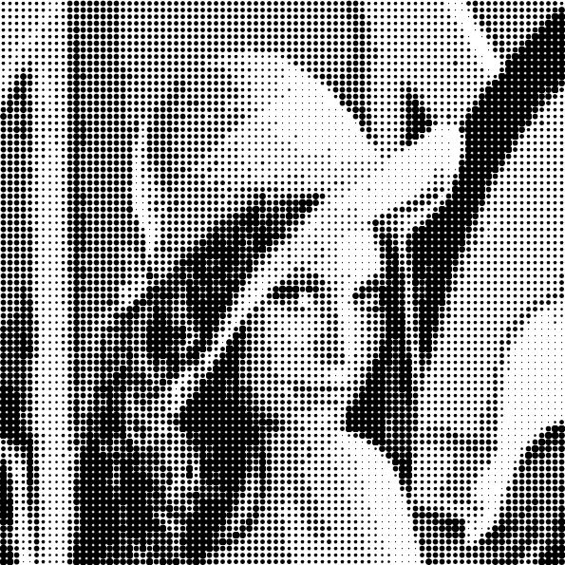
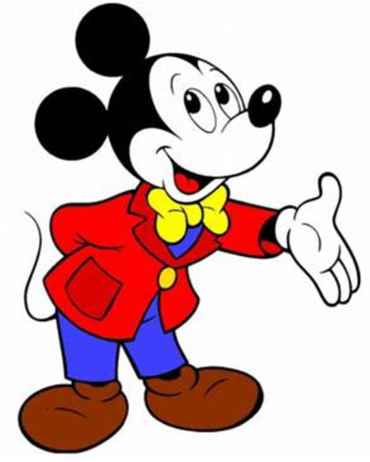

Image Halftoning
Online editor:
http://www.picturetopeople.org/image_effects/photo-halftone/halftone-image-generator.html

Slide 8
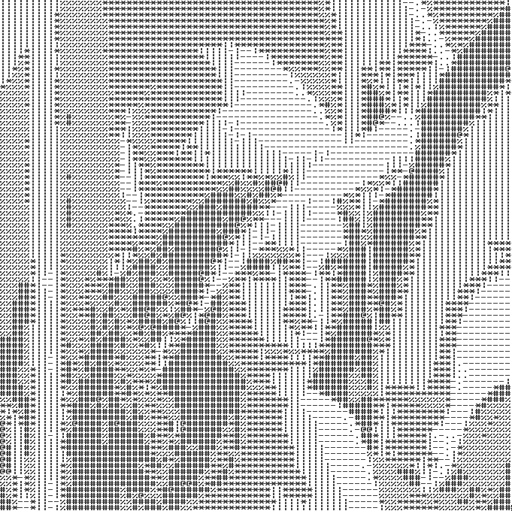
Image halftoning
Applications
Newspaper
Japanese comic, also known as manga.
ASCII art.

Slide 9
Assignment 1
The assignment 1 will require you to write a simple image halftoning program.
The assignment will be divided into 2 parts:
basic part
bonus part
Notes:
The assignment will be divided into 2 parts: basic part and bonus part.
The basic part is very very easy!
The bonus part takes little percentage.

Slide 10
Outline
Part 1 Introduction to Halftone
Part 2 Assignment 1 basic part
Part 3 Assignment 1 bonus part
Part 4 Other requirements

Slide 11
Basic Part
1. Reading RGB image 15%
2. Resize the image 15%
3. Obtain Luma (Brightness) 15%
4. Quantization 15%
5. Patch Mapping 30%
6. Save image 10%

Slide 12
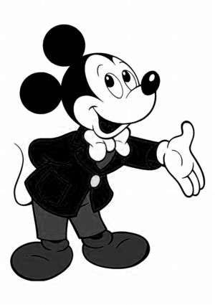
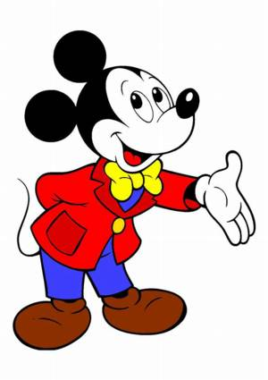
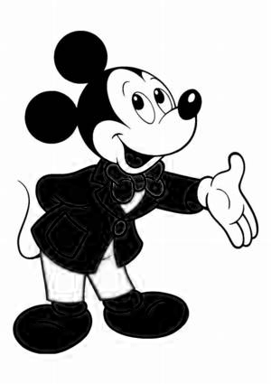
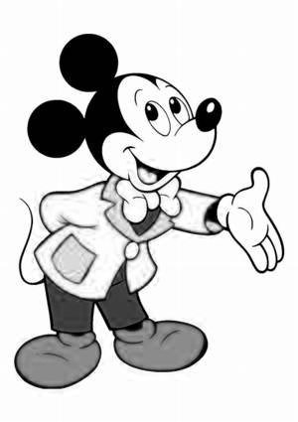
1.Reading RGB image
Read in the .bmp as an RGB image
The struct is also simple:
struct Color{ unsigned char r; unsigned char g; unsigned char b; };
The r, g, b represent RGB channels.
Code fragment for read/write/resize .bmp format is provided in the skeleton code.
bmp.h & bmp.cpp
B
G
R
Notes:
Each pixel has R, G and B channels and each channel uses ‘unsigned char’ (i.e. one single byte) as their storage unit.
A simple .bmp file library is included in the package

Slide 13
1.Reading RGB image
Notes:
A image is stored as a matrix that includes color information for each pixel. Each pixel is represented with a figure range from 0 to 255. The smaller the value, the darker. Otherwise, the brighter.

Slide 14
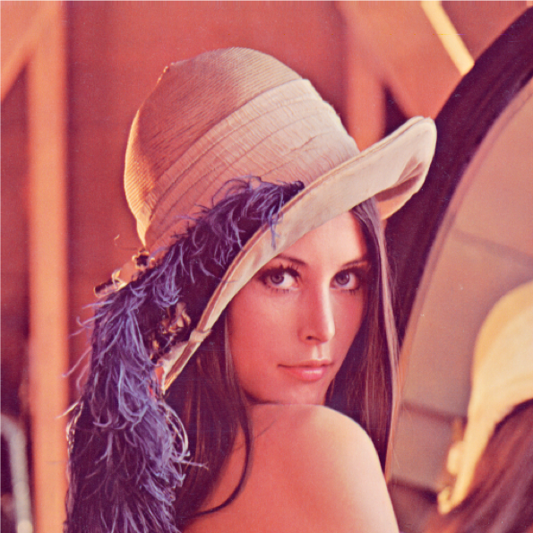
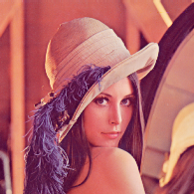
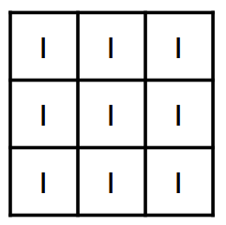
2.Resize the image
Resize the image according to the user-specified limited size.
Resize
?
1/9

Slide 15

3.From RGB to gray
Next, we need to convert a color image to a gray one.
We use the formula: gray value = 0.299 * R + 0.587 * G + 0.114 * B

Slide 16
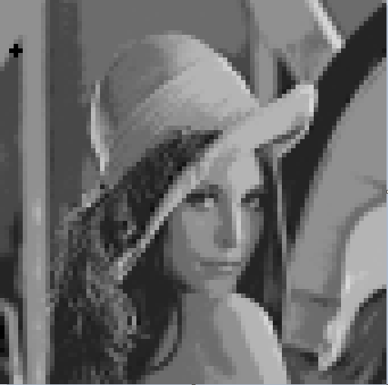
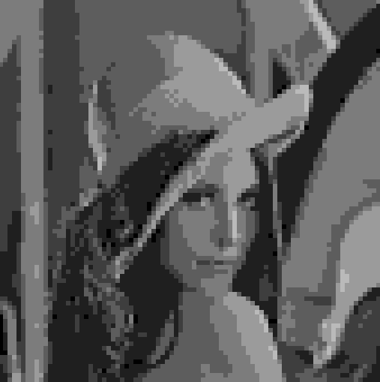
4.Quantization
Quantize the grayscale values into n levels
It can be achieved by: quantized value = floor(gray value / (256/n))
Quantization
?
Continunous-tone : 0 ~ 255
Availabel value: 0 to n-1

Slide 17
4.Quantization
0-255
0-5

Slide 18



5.Patch Mapping
Map each level to an element from the given image patch set.
0
1
2

Slide 19

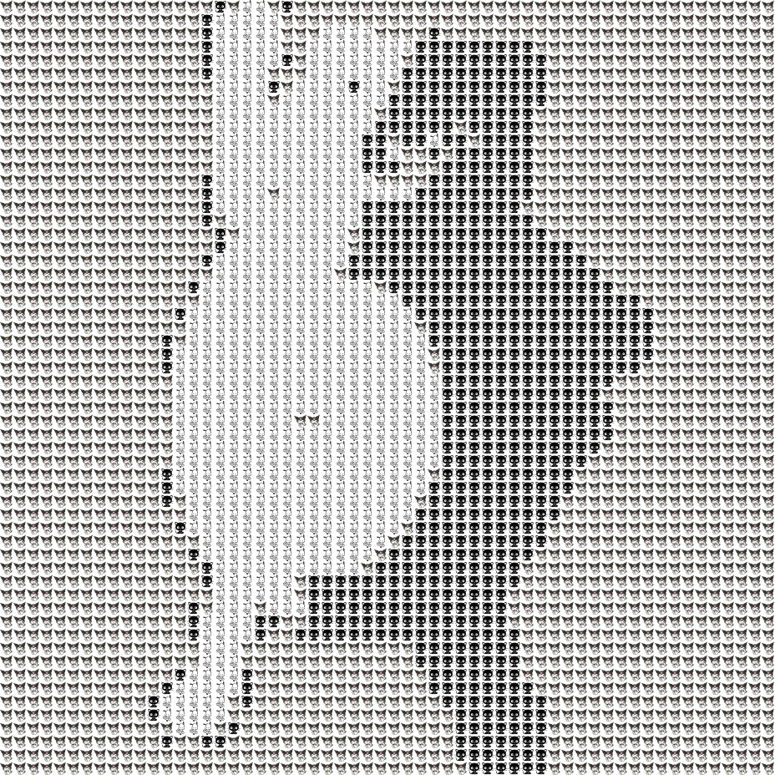
6.Image output and saving

Slide 20
Outline
Part 1 Introduction to Halftone
Part 2 Assignment 1 basic part
Part 3 Assignment 1 bonus part
Part 4 Other requirements

Slide 21
Bonus part
Able to resize the image to specific width and height
Quantized image based on statistics
Impress us and be creative!

Slide 22
Outline
Part 1 Introduction to Halftone
Part 2 Assignment 1 basic part
Part 3 Assignment 1 bonus part
Part 4 Other requirements

Slide 23
Requirements
Program must be coded in ANSI C/C++ and use standard libraries only.
Code fragment for read/write/resize .bmp format is provided in the skeleton code.

Slide 24
Requirements
Compile with Visual Studio 2015 C++ compiler
Tools → Command Prompt
>> cl halftone.cpp bmp.cpp

Slide 25
Requiremets
Your program should be run under cmd environment in Windows as format:
>> halftone <input.bmp> <size1> <size2>

Slide 26
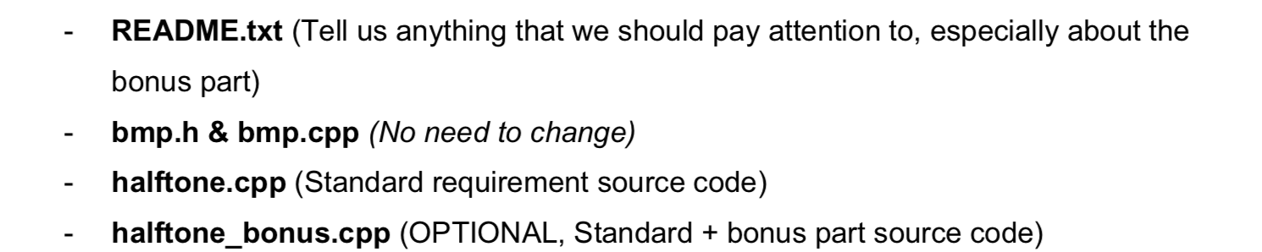
Requiremets
Visual Studio 2015 C++ compiler
Submit source code only (readme.txt).
Submit through blackboard: http://blackboard.cuhk.edu.hk
Due date: Feb. 07, 2020 (11:59pm)
Zipped File (e.g.1155103490.zip)

Slide 27
Marking Schemes
Basic part 100%
Bonus part 10%
_________________________
Total 100%
Notes:
That all about the assignment 1.

Slide 28
Reference
https://engineering.purdue.edu/~bouman/ece637/notes/pdf/Halftoning.pdf
https://www.researchgate.net/profile/Ea_Riskin/publication/2397054/figure/fig5/AS:668755948474391@1536455251734/The-512-512-Lena-test-image-a-The-original-b-Compressed-at-02-bpp-with-SPIHT.ppm
http://www.vanderlee.com/plugins/halftone/halftone_plugin_example_newspaper.jpg
https://encrypted-tbn0.gstatic.com/images?q=tbn:ANd9GcTP1_HZsCoLfIsKaCcDth0n_1LVelXPQN8JmLBL33tobsSqH3ojNw&s
https://images-na.ssl-images-amazon.com/images/I/41EZtycCC3L._SX425_.jpg
https://i.pinimg.com/originals/f7/ab/95/f7ab9534bbd28a237f71cf6513624685.png
https://i.pinimg.com/originals/4c/48/95/4c48954e113754b9988546375e04c84e.jpg

Slide 29
Reference
https://vignette.wikia.nocookie.net/dragonball/images/3/36/DBFCM_008.jpg/revision/latest/scale-to-width-down/649?cb=20131212073535
http://media.abcya.games/images/300/color-pixel-art-classic15467480218181.jpg
https://www.researchgate.net/profile/Md_Badrul_Miah/publication/284003940/figure/fig2/AS:391740121993216@1470409531018/The-pixel-matrix-feature-extraction-method.png
http://clipart-library.com/clipart/yckrBqroi.htm
https://en.wikipedia.org/wiki/Halftone

Slide 30
Thank you.
XIE Minshan msxie@cse.cuhk.edu.hk

